Slide 1
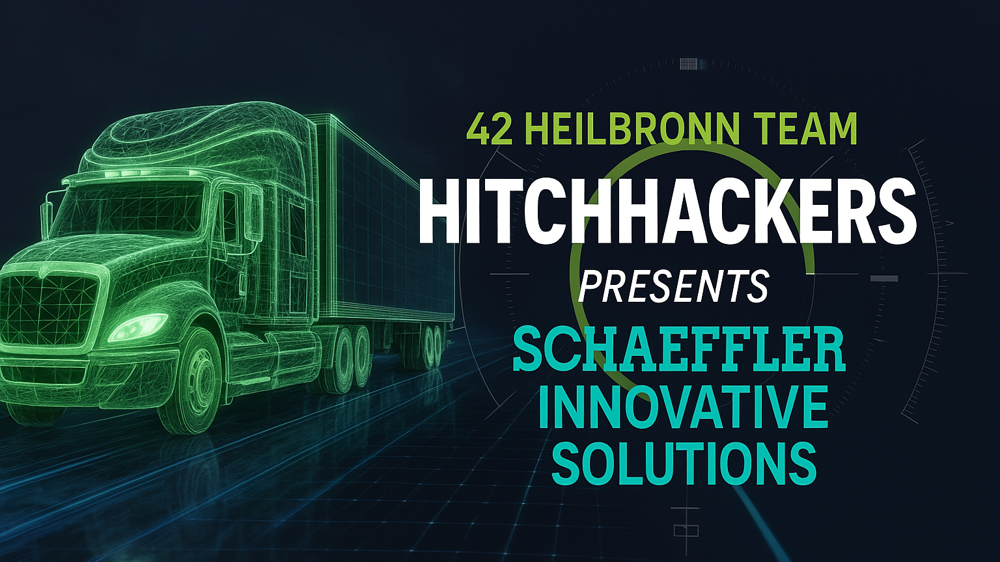
Notes:
Good afternoon everyone, We are Hitch Hackers, a hackathon team of students from 42 Heilbronn, and today we are going to show you an innovative solution to real world manufacturing problems, by answering schaefflers challenge by leverage their technology and workflow, to bring manufacturing into the future.

Slide 2
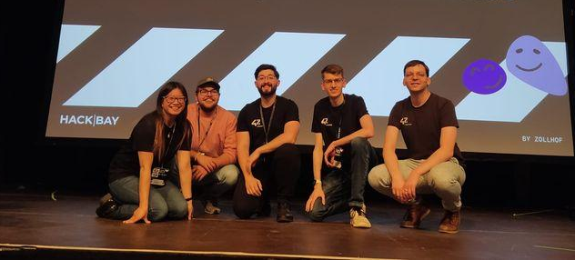


The Team: Hitch Hackers 42
Manual Labor
Rigid Robotics
Linda, Daniel, David, Robin, Benjamin
https://www.linkedin.com/in/linda-lacsivy-a75875304/
https://www.linkedin.com/in/danielgessner/
https://www.linkedin.com/in/biermandavid/
https://www.linkedin.com/in/robin-g%C3%B6hrig-516b05273/
https://www.linkedin.com/in/benjamin-werner-333ba929a/
Notes:
Good afternoon everyone, We are Hitch Hackers, a hackathon team of students from 42 Heilbronn, and today we are going to show you an innovative solution to real world manufacturing problems, by answering schaefflers challenge by leverage their technology and workflow, to bring manufacturing into the future.

Slide 3
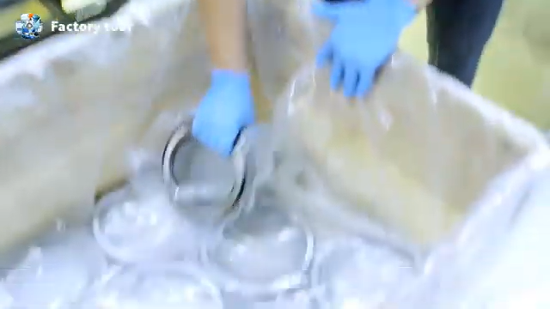
The Problem – Labor Bottleneck
Manual Labor
Labor constraints growing
Inventory Outpaces labor Capacity
Product Delays
Notes:
The problem we are trying to solve has two pretty severe bottlenecks, Manual Labor doesn’t scale with growing inventory, new products and competing resource space in the warehouse.

Slide 4
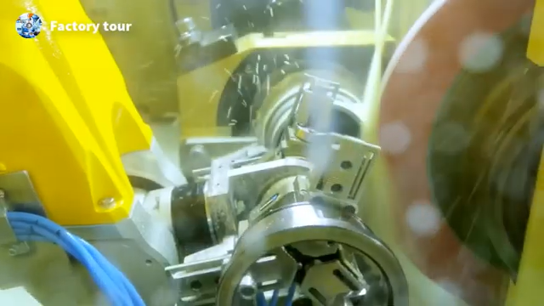
The Problem – Robotics Bottleneck
Ageing Technology
Legacy Systems don’t scale
Slow to Adapt to new inventory reqs
Still Dependant on manual intervention
Notes:
On top of that, the robotics solutions of old aren’t scaling well either, we are repeating the same movements, introducing long delays for new products to be hard coded in the front lines, and at the end of the day, we still require manual labour to get this to the next step.

Slide 5
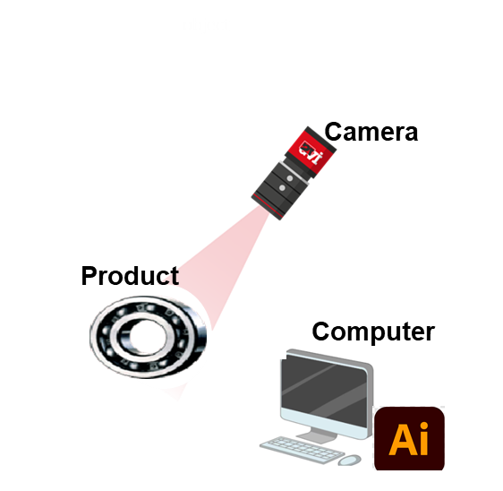
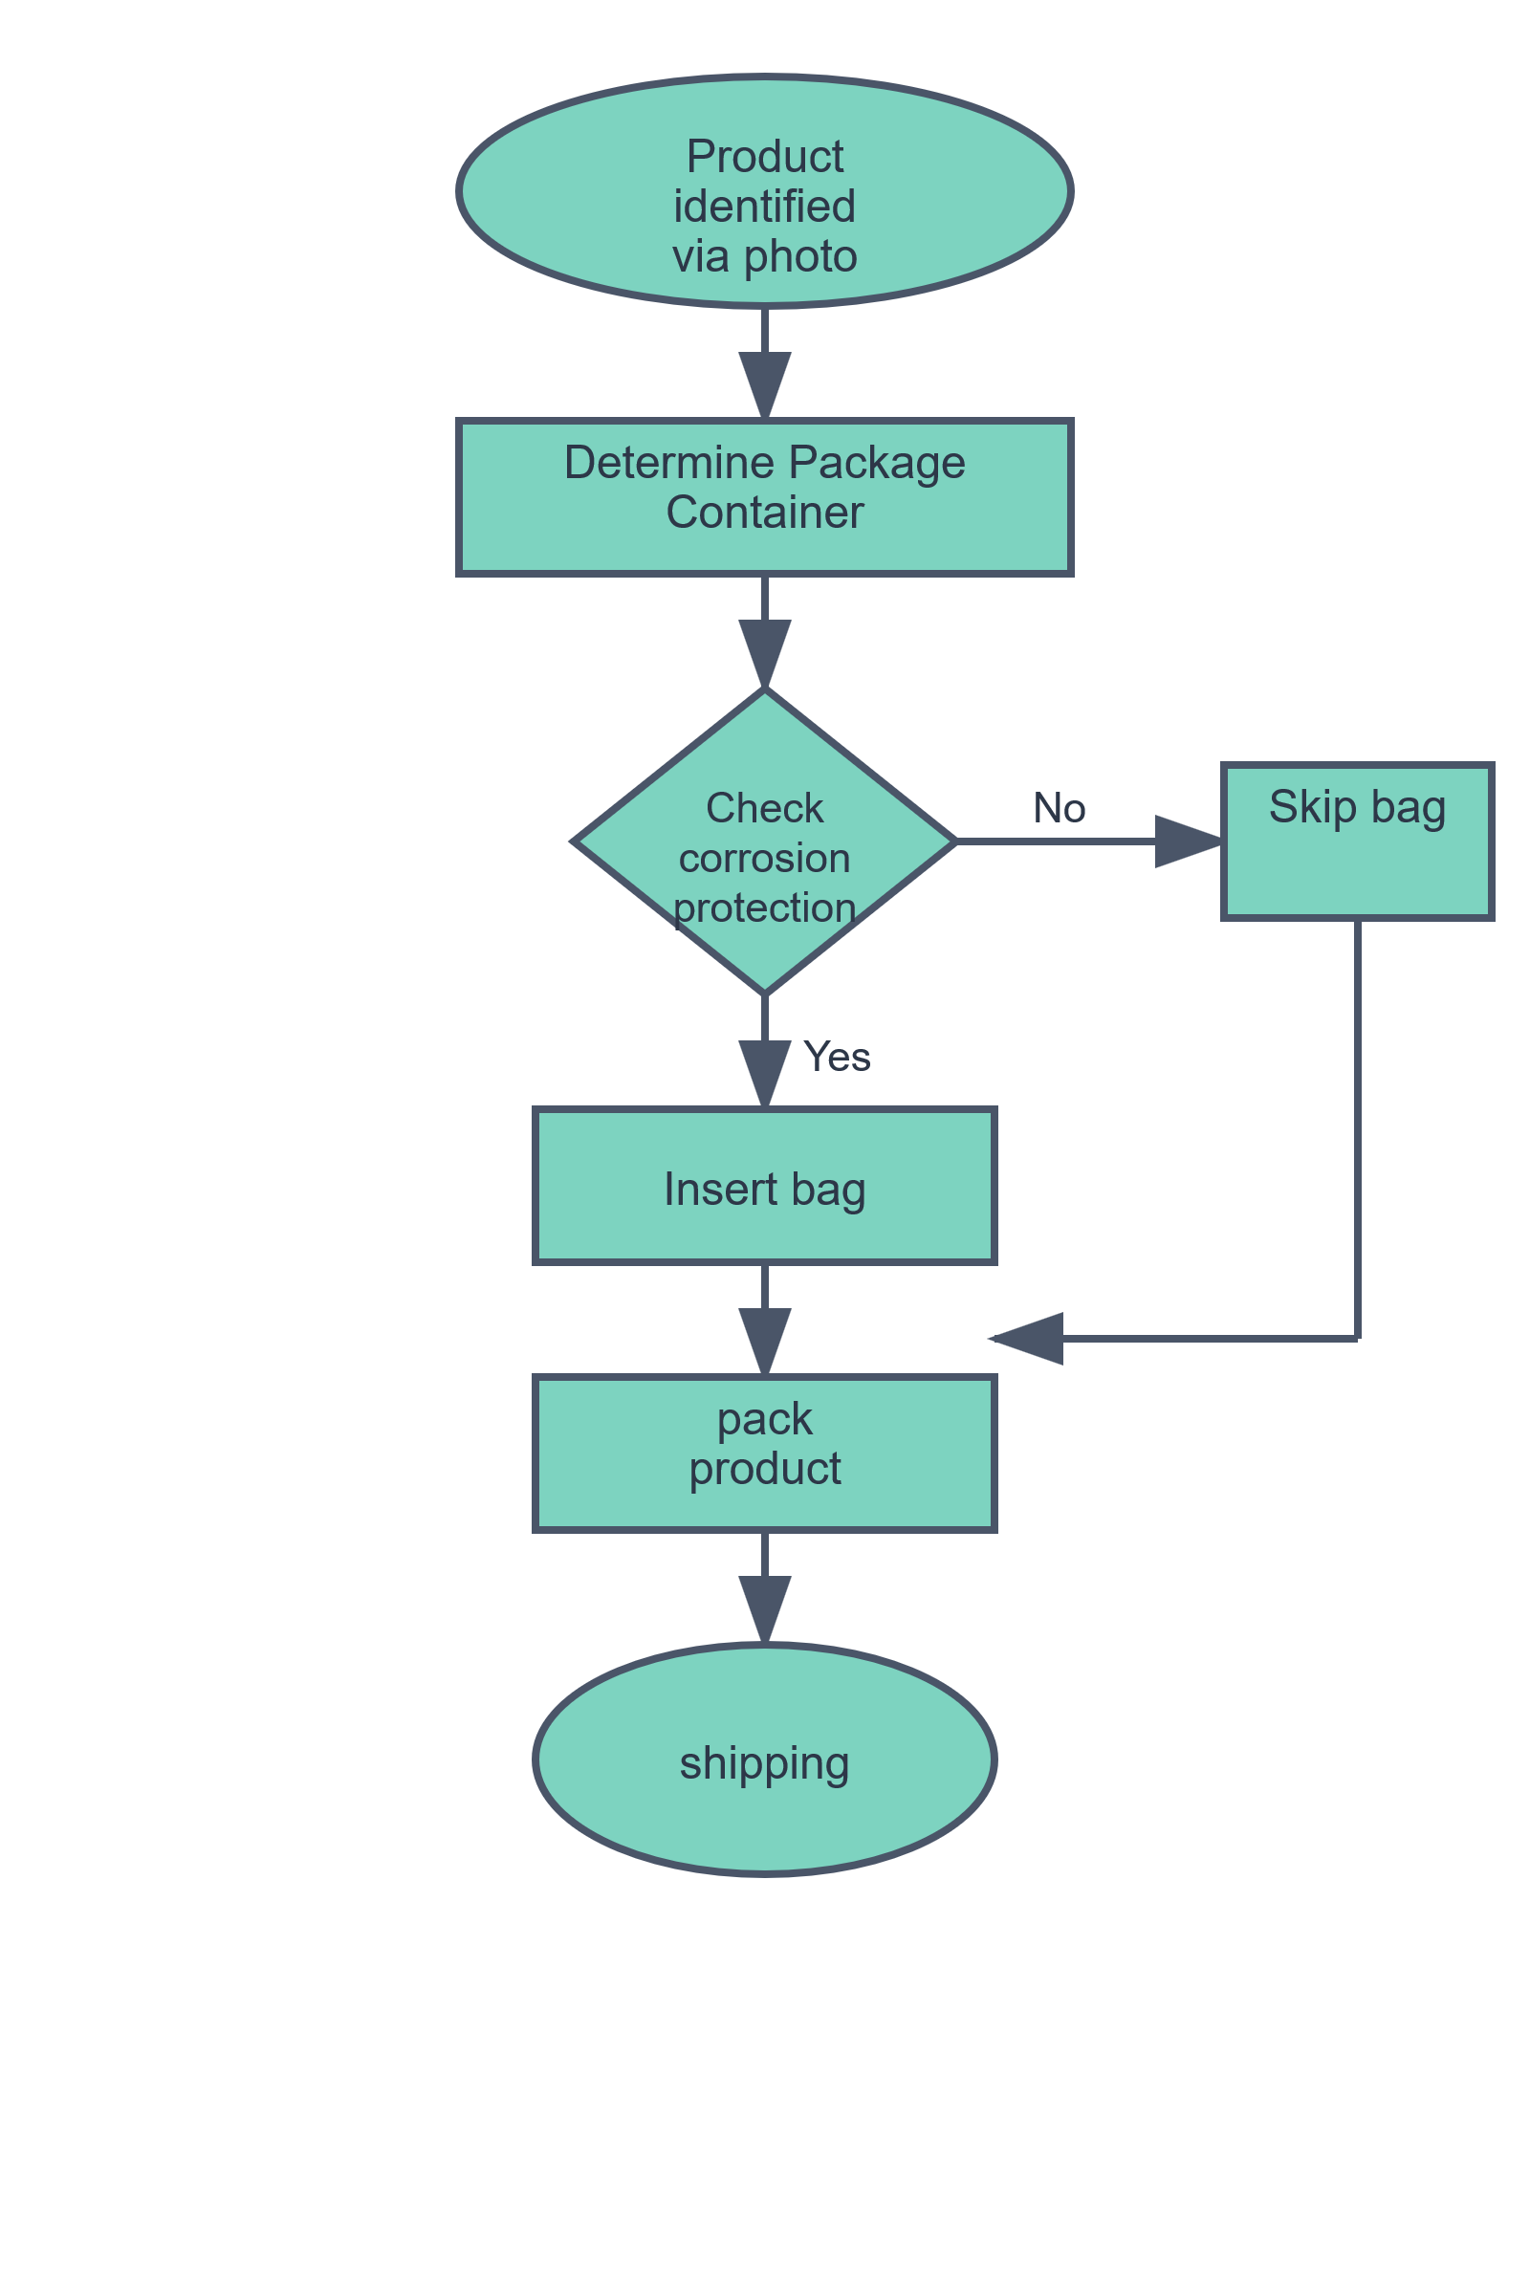

Optimized architecture solution with AI workflow
Adaptive Packaging Solution
Our system replaces both:
manual labor
Outdated tech solutions.
Computer Vision-Based Box Selection
Enhanced Workflow
We use vision technology:
We use
Wave power Wind power
Instantly detect product size, shape and weight.
Select the right box
Insert corrosion bag (if required)
Pick, place, pack and ship.
Camera takes photo of the product on assembly line. An AI workflow agent analyzes the image to identify the product ID and correct packing materials
Notes:
This takes us to the next part of this brief, Linda is going to introduce you to our proposed workflow, and how this can be used to revolutionize and modernize production. Ok now Linda briefs the packaging solution, computer vision and workflow.
Impressive right? Okay now lets put our money where our mouth is and show you how we do it (show demo next slide)

Slide 6
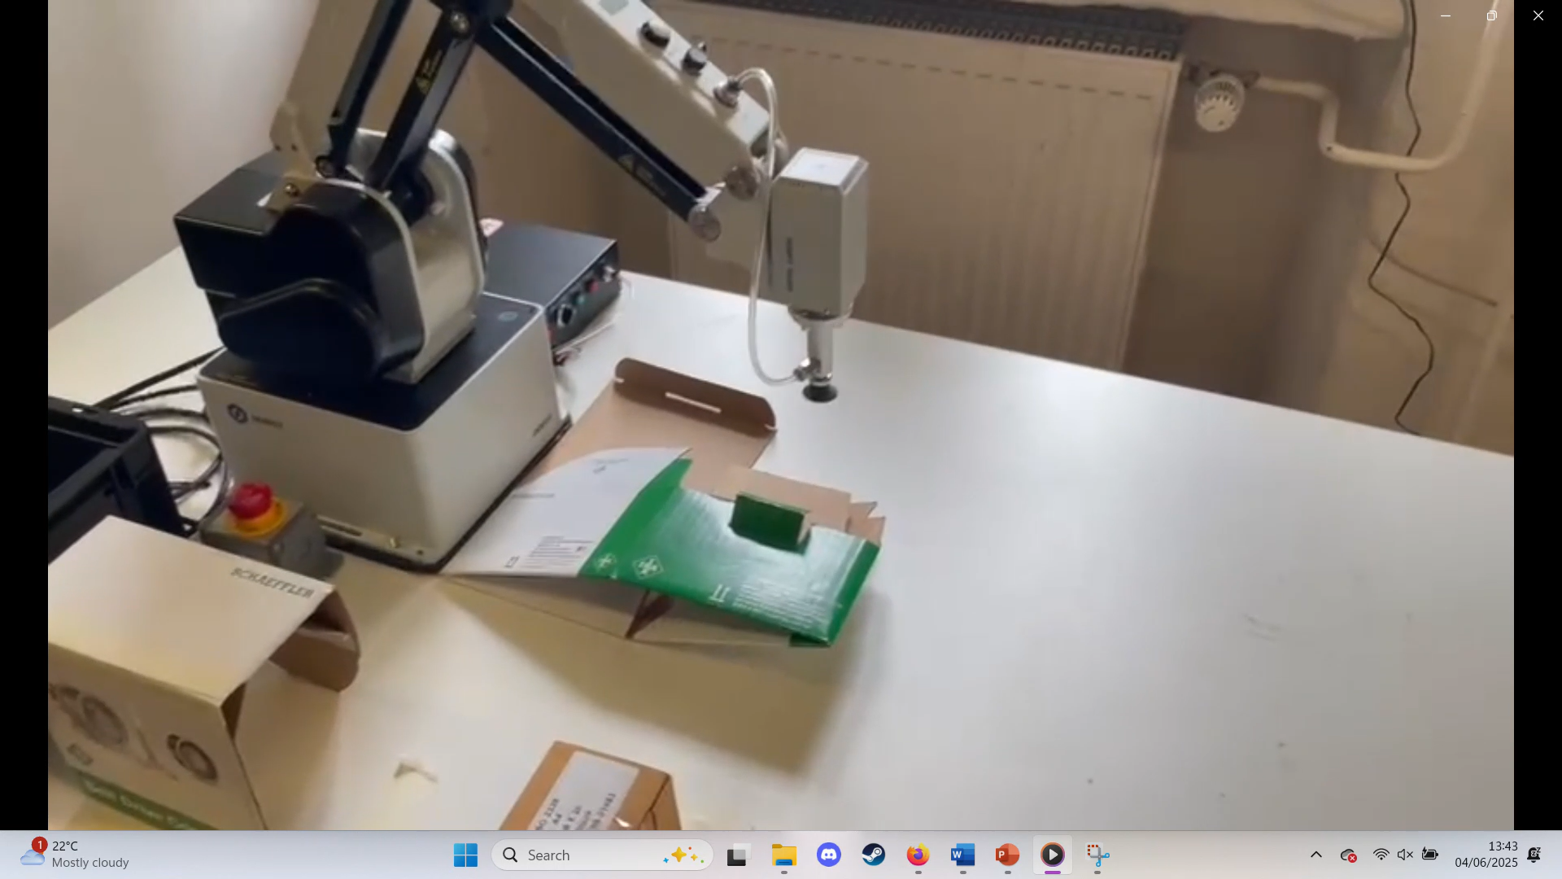
Simulated Robotics Solution Demo
Notes:
Okay maybe here we show them our demo, explain how swapping the heads dynamically would allow you to complete more tasks, faster, and with less machinery. And then segwaying on how this would look on the assembly line with our AI powered solution Sick B Roll solution with the uwu badabing

Slide 7
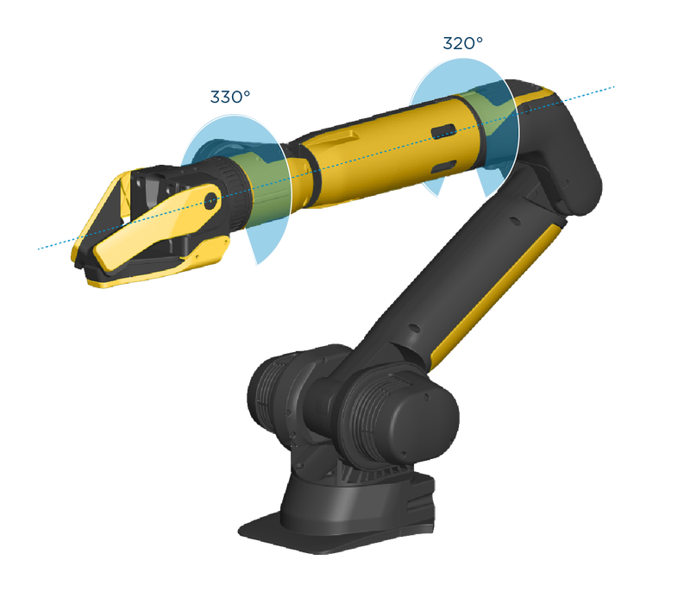
Simulated Robotics Solution Demo
Notes:
Okay maybe here we show them our demo, explain how swapping the heads dynamically would allow you to complete more tasks, faster, and with less machinery. And then segwaying on how this would look on the assembly line with our AI powered solution Sick B Roll solution with the uwu badabing

Slide 8
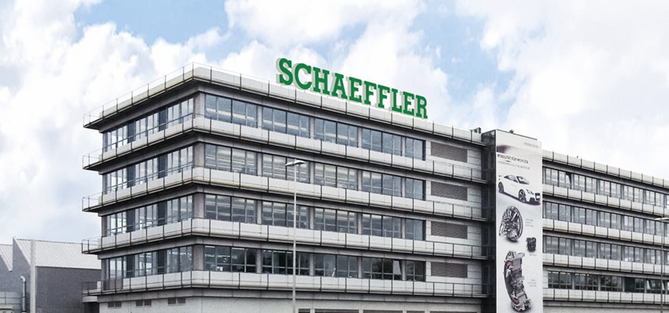
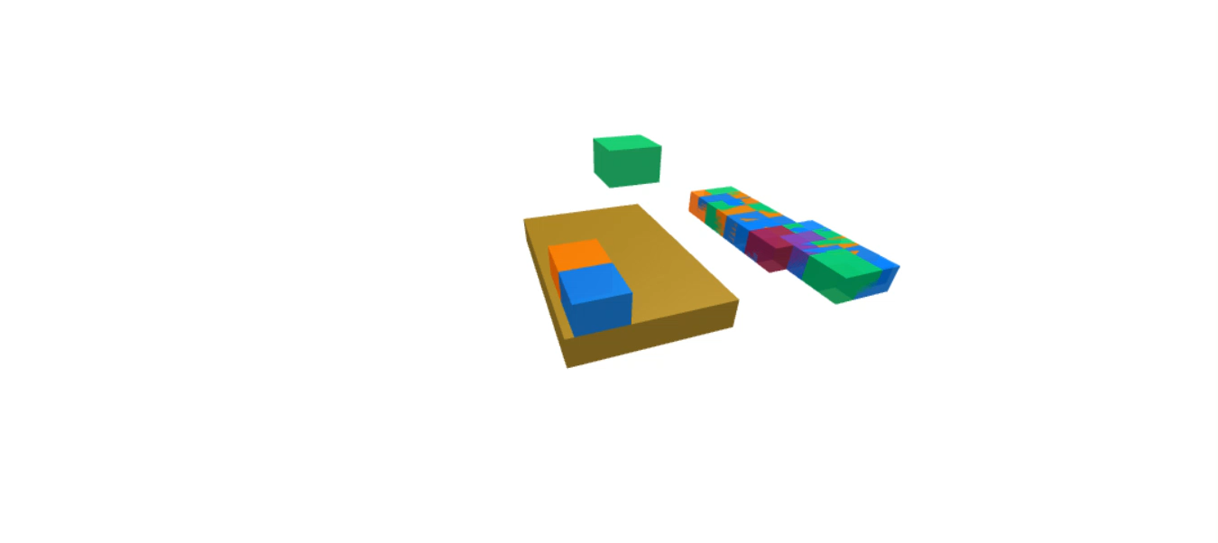
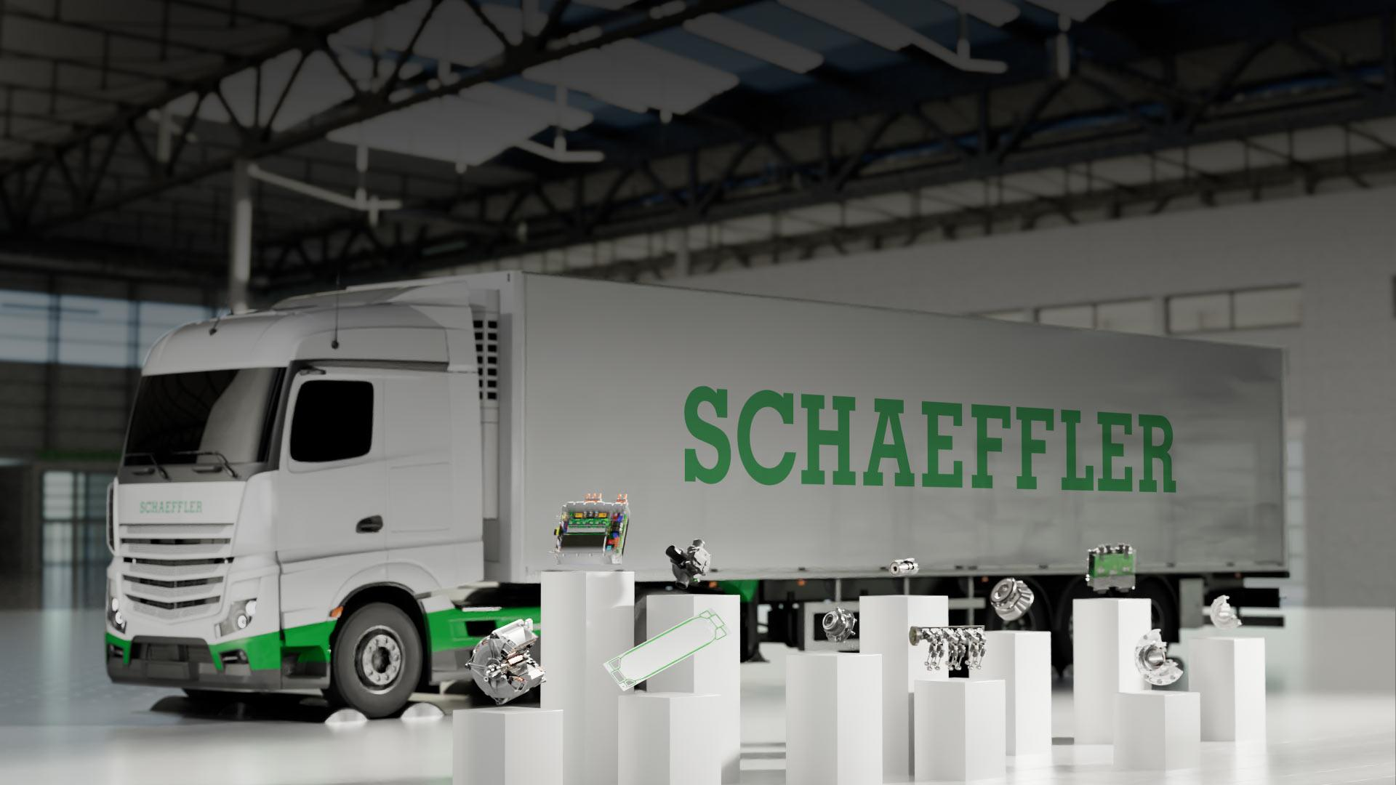
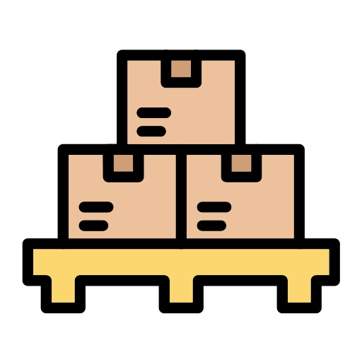

Optimized Shipping Solution
Automated Label & Pallet Sorting streamlines operations
Reduced Labor Costs to implement robotic solution
Lowered transportation expenses.
Prevents inefficient deliveries with underfilled pallets
Notes:
Now that you’ve seen what this looks like in practice, we don’t just plan on making a robot fill boxes, we plan on revolutionizing the full lifecycle of manufacturing. With our adaptive AI agents powered by robotics, we can even calculate the most efficient pallet loads to reduce transportation expenses, save warehouse space, stop wasting petrol and harming the environment with half filled trucks. Whether you use a robot to load the pallet, or if you still rely on human labour, this can still be used to save time and resources.

Slide 9
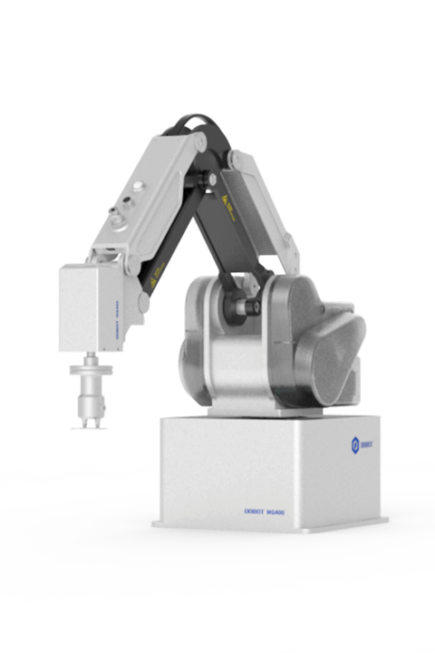
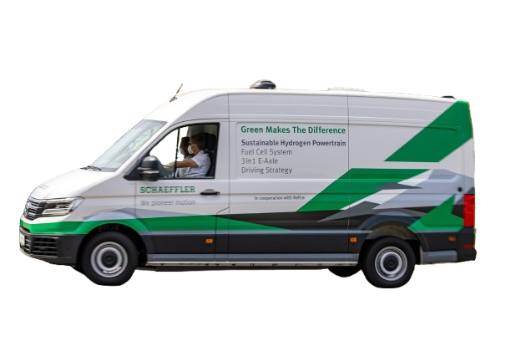

The Way Ahead
Brings Manufacturing into the future with AI
Scalability outside of limited test case
Reduced Cost and Environmental Burden
Efficient Delivery
Schaeffler Robotics
Optimized
Packing
Enhanced with Adaptive AI
Notes:
Now, youre probably wondering what makes this solution truly unique, were not just showing you how to wrap a Christmas present, we are compiling a multitool of solutions to work for your needs, Robotics with human-like adaptability to the constantly changing business domain. Leveraging, smart AI ML solutions to the full lifecycle of the manufacturing process. At the end of the day, if this works here with Schaeffler, why not in all of Germany, even better, why stop there, why not all of the EU? Thank you guys for your time ☺

Slide 10
Questions?

